Slide 1
Pong World Tournament
Tournament Rules
Players will be randomly assigned to a slot (Player 1 to Player 10).
Each match consists of 5 independent games, with players alternating sides of the board.
The first player to win 3 or more games wins the match.
Match winners advance to the next round and face new opponents.
The tournament champion earns +1 extra point.

Slide 2

Tournament

Slide 3
Group xx
---
Group xx
---
Group xx
---
---
Group xx
Group xx
---
Group xx
---
Group xx
---
Group xx
---
Group xx
---
Group xx
Initial round
Quarter finals
Semifinals
Final

Slide 4
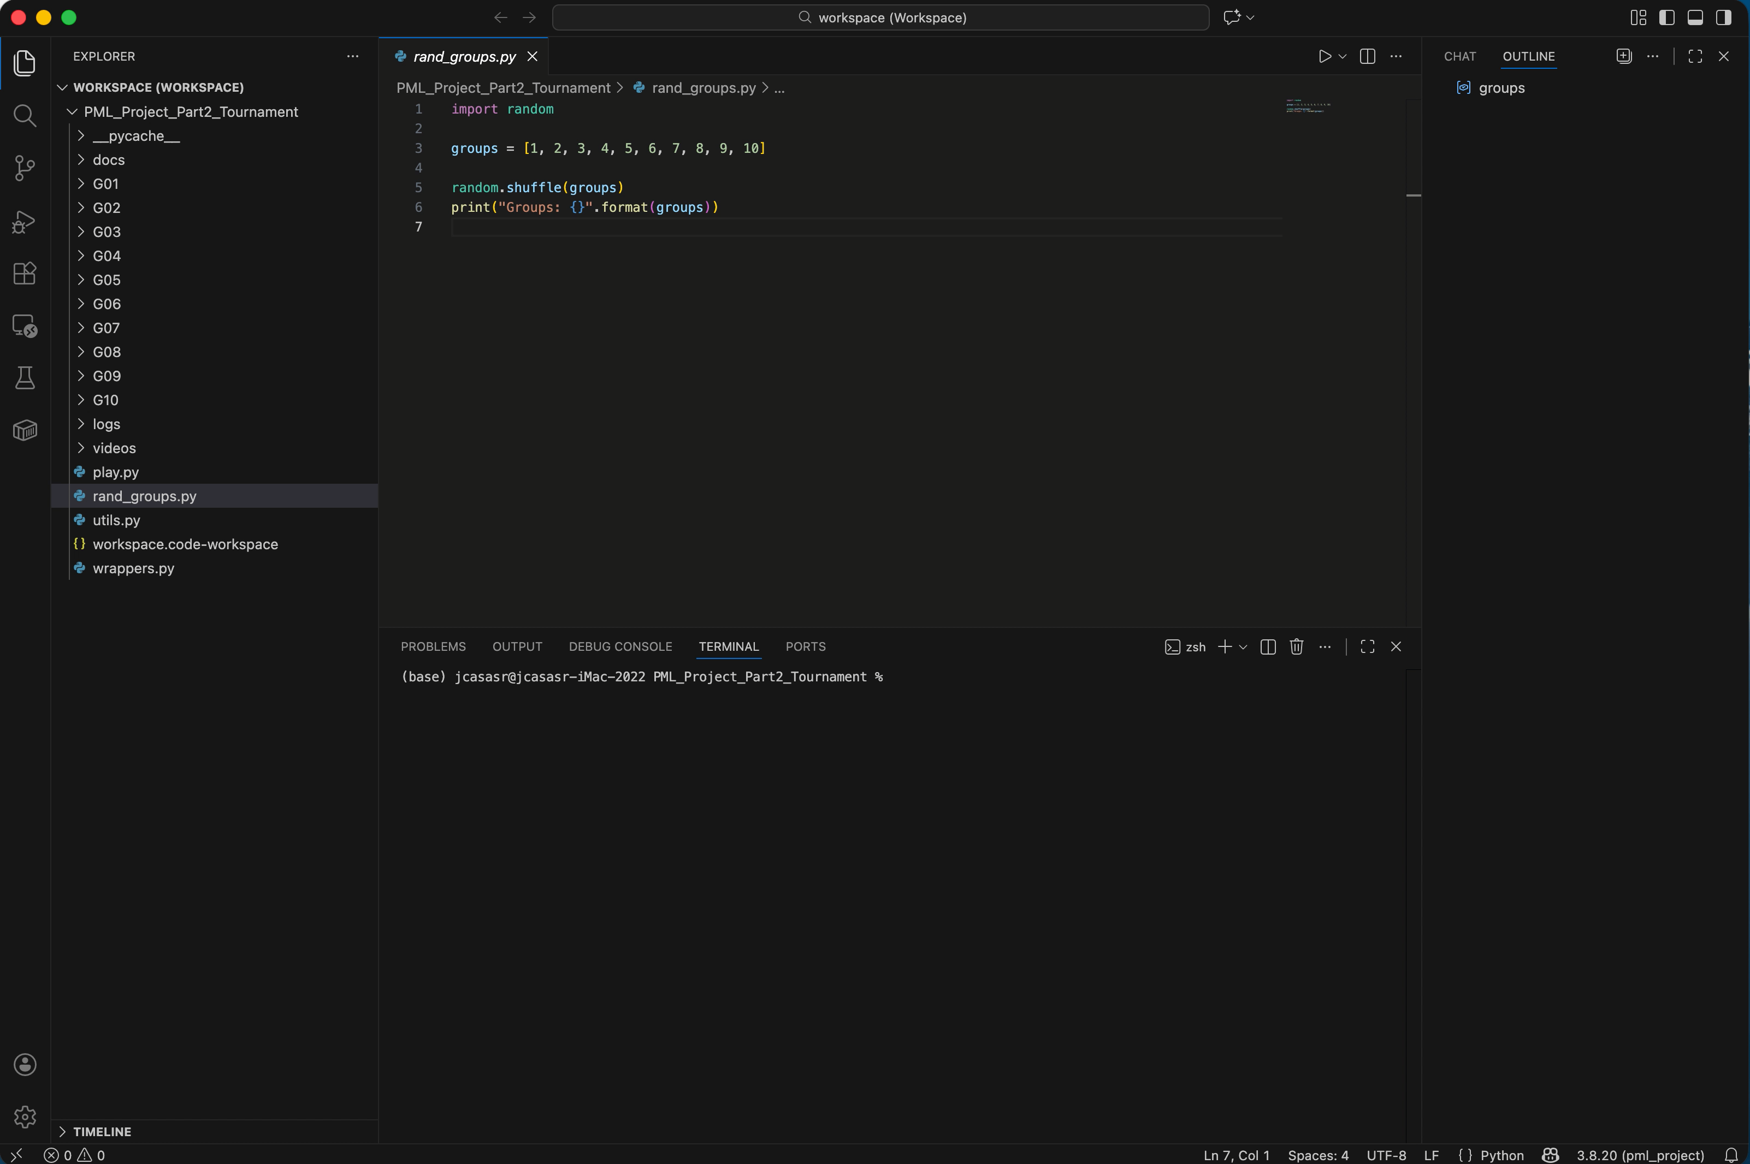

Slide 5
Group 04
---
Group 06
---
Group 10
---
---
Group 03
Group 09
---
Group 01
---
Group 07
---
Group 02
---
Group 05
---
Group 08
Initial round
Quarter finals
Semifinals
Final

Slide 6
Initial Round

Slide 7
Group 04
---
Group 06
---
Group 10
---
---
Group 03
Group 09
---
Group 01
---
Group 07
---
Group 02
---
Group 05
---
Group 08
Initial Round
Quarter finals
Semifinals
Final

Slide 8
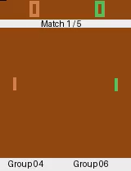
Group 04 vs Group 06 Match 1 / 5 Group 04: 0 Group 06: 0

Slide 9
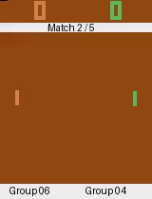
Group 04 vs Group 06 Match 2 / 5 Group 04: 1 Group 06: 0

Slide 10
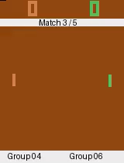
Group 04 vs Group 06 Match 3 / 5 Group 04: 2 Group 06: 0

Slide 11
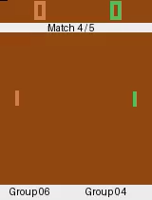
Group 04 vs Group 06 Match 4 / 5 Group 04: 2 Group 06: 1

Slide 12

Group 04 vs Group 06 Match 5 / 5 Group 04: 2 Group 06: 2

Slide 13


Group 04 vs Group 06 Result Group 04: 3 Group 06: 2

Slide 14
Group 04
Group 04
Group 06
---
Group 10
---
---
Group 03
Group 09
---
Group 01
---
Group 07
---
Group 02
---
Group 05
---
Group 08
Initial Round
Quarter finals
Semifinals
Final

Slide 15
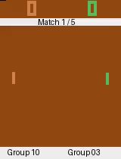
Group 10 vs Group 03 Match 1 / 5 Group 10: 0 Group 03: 0

Slide 16
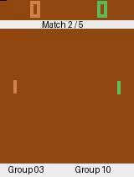
Group 10 vs Group 03 Match 2 / 5 Group 10: 1 Group 03: 0

Slide 17
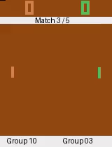
Group 10 vs Group 03 Match 3 / 5 Group 10: 2 Group 03: 0

Slide 18
Group 10 vs Group 03 Result
Group 10: 3 Group 03: 0

Slide 19
Group 04
Group 04
Group 06
---
Group 10
Group 10
---
Group 03
Group 09
---
Group 01
---
Group 07
---
Group 02
---
Group 05
---
Group 08
Initial Round
Quarter finals
Semifinals
Final

Slide 20
Quarter Finals

Slide 21
Group 04
Group 04
Group 06
---
Group 10
Group 10
---
Group 03
Group 09
---
Group 01
---
Group 07
---
Group 02
---
Group 05
---
Group 08
Initial Round
Quarter finals
Semifinals
Final

Slide 22

Group 05 vs Group 08 Match 1 / 5 Group 05: 0 Group 08: 0

Slide 23
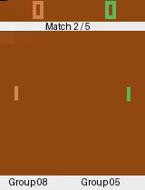
Group 05 vs Group 08 Match 2 / 5 Group 05: 1 Group 08: 0

Slide 24
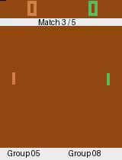
Group 05 vs Group 08 Match 3 / 5 Group 05: 2 Group 08: 0

Slide 25
Group 05 vs Group 08 Result Group 05: 3 Group 08: 0

Slide 26
Group 04
Group 04
Group 06
---
Group 10
Group 10
---
Group 03
Group 09
---
Group 01
---
Group 07
---
Group 02
---
Group 05
Group 05
Group 08
Initial Round
Quarter finals
Semifinals
Final

Slide 27
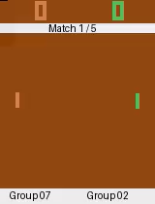
Group 07 vs Group 02 Match 1 / 5 Group 07: 0 Group 02: 0

Slide 28

Group 07 vs Group 02 Match 2 / 5 Group 07: 0 Group 02: 1

Slide 29
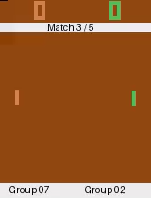
Group 07 vs Group 02 Match 3 / 5 Group 07: 1 Group 02: 1

Slide 30

Group 07 vs Group 02 Match 4 / 5 Group 07: 2 Group 02: 1

Slide 31
Group 07 vs Group 02 Result Group 07: 3 Group 02: 1

Slide 32
Group 04
Group 04
Group 06
---
Group 10
Group 10
---
Group 03
Group 09
---
Group 01
---
Group 07
Group 07
Group 02
---
Group 05
Group 05
Group 08
Initial Round
Quarter finals
Semifinals
Final

Slide 33
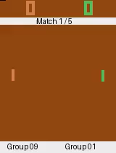
Group 09 vs Group 01 Match 1 / 5 Group 09: 0 Group 01: 0

Slide 34
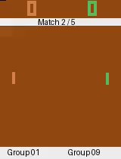
Group 09 vs Group 01 Match 2 / 5 Group 09: 0 Group 01: 1

Slide 35

Group 09 vs Group 01 Match 3 / 5 Group 09: 1 Group 01: 1

Slide 36
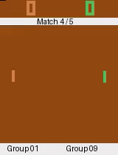
Group 09 vs Group 01 Match 4 / 5 Group 09: 1 Group 01: 2

Slide 37
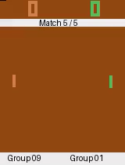
Group 09 vs Group 01 Match 5 / 5 Group 09: 2 Group 01: 2

Slide 38
Group 09 vs Group 01 Result Group 09: 2 Group 01: 3

Slide 39
Group 04
Group 04
Group 06
---
Group 10
Group 10
---
Group 03
Group 09
Group 01
Group 01
---
Group 07
Group 07
Group 02
---
Group 05
Group 05
Group 08
Initial Round
Quarter finals
Semifinals
Final

Slide 40

Group 04 vs Group 10 Match 1 / 5 Group 04: 0 Group 10: 0

Slide 41

Group 04 vs Group 10 Match 2 / 5 Group 04: 0 Group 10: 1

Slide 42

Group 04 vs Group 10 Match 3 / 5 Group 04: 0 Group 10: 2

Slide 43
Group 04 vs Group 10 Result Group 04: 0 Group 10: 3

Slide 44
Group 04
Group 04
Group 06
Group 10
Group 10
Group 10
---
Group 03
Group 09
Group 01
Group 01
---
Group 07
Group 07
Group 02
---
Group 05
Group 05
Group 08
Initial Round
Quarter finals
Semifinals
Final

Slide 45
Semifinals

Slide 46
Group 04
Group 04
Group 06
Group 10
Group 10
Group 10
---
Group 03
Group 09
Group 01
Group 01
---
Group 07
Group 07
Group 02
---
Group 05
Group 05
Group 08
Initial Round
Quarter finals
Semifinals
Final

Slide 47
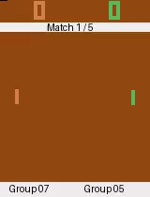
Group 07 vs Group 05 Match 1 / 5 Group 07: 0 Group 05: 0

Slide 48

Group 07 vs Group 05 Match 2 / 5 Group 07: 1 Group 05: 0

Slide 49

Group 07 vs Group 05 Match 3 / 5 Group 07: 2 Group 05: 0

Slide 50
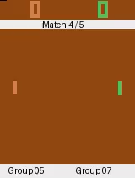
Group 07 vs Group 05 Match 4 / 5 Group 07: 2 Group 05: 1

Slide 51
Group 07 vs Group 05 Result Group 07: 3 Group 05: 1

Slide 52
Group 04
Group 04
Group 06
Group 10
Group 10
Group 10
---
Group 03
Group 09
Group 01
Group 01
---
Group 07
Group 07
Group 02
Group 07
Group 05
Group 05
Group 08
Initial Round
Quarter finals
Semifinals
Final

Slide 53

Group 10 vs Group 01 Match 1 / 5 Group 10: 0 Group 01: 0

Slide 54

Group 10 vs Group 01 Match 2 / 5 Group 10: 1 Group 01: 0

Slide 55
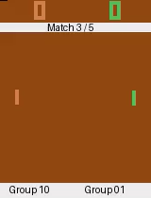
Group 10 vs Group 01 Match 3 / 5 Group 10: 2 Group 01: 0

Slide 56
Group 10 vs Group 01 Result Group 10: 3 Group 01: 0

Slide 57
Group 04
Group 04
Group 06
Group 10
Group 10
Group 10
Group 10
Group 03
Group 09
Group 01
Group 01
---
Group 07
Group 07
Group 02
Group 07
Group 05
Group 05
Group 08
Initial Round
Quarter finals
Semifinals
Final

Slide 58
The Final Match

Slide 59
Group 04
Group 04
Group 06
Group 10
Group 10
Group 10
Group 10
Group 03
Group 09
Group 01
Group 01
---
Group 07
Group 07
Group 02
Group 07
Group 05
Group 05
Group 08
Initial Round
Quarter finals
Semifinals
Final

Slide 60

Group 10 vs Group 07 Match 1 / 5 Group 10: 0 Group 07: 0

Slide 61

Group 10 vs Group 07 Match 2 / 5 Group 10: 0 Group 07: 1

Slide 62
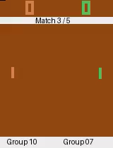
Group 10 vs Group 07 Match 3 / 5 Group 10: 0 Group 07: 2

Slide 63
Group 10 vs Group 07 Result Group 10: 0 Group 07: 3

Slide 64
Group 04
Group 04
Group 06
Group 10
Group 10
Group 10
Group 10
Group 03
Group 09
Group 01
Group 01
Group 07
Group 07
Group 07
Group 02
Group 07
Group 05
Group 05
Group 08
Initial Round
Quarter finals
Semifinals
Final

Slide 65
And the winner is... Group 07!

